Slide 1
Credit Card Fraud Detection
Leveraging AI-Driven Solution to Detect and Prevent Fraud
Rebecca Cloe, Greg Bauer, Birendra Khimding
Shiley-Marcos School of Engineering, University of San Diego
AAI-510 Machine Learning Fundamentals and Applications
Professor Mirsardar Esmaeili

Slide 2
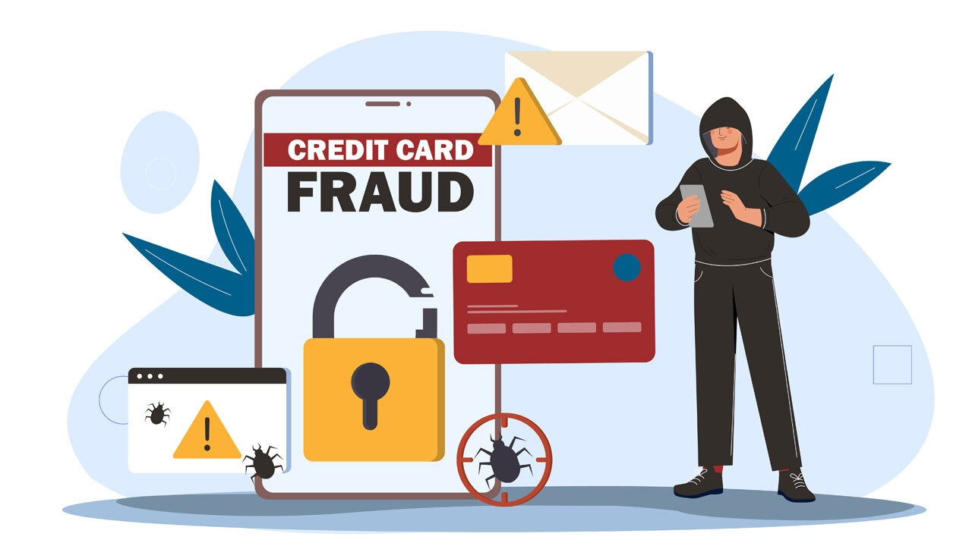
Introduction
Protecting Customer & Profit against Credit Card Fraud
Credit card fraud results in billions of dollars in loss every year globally.
Credit card fraud detection is a critical task for financial institutions due to its potential for large monetary losses and compromised customer trust.
With the increase in online transactions, organizations are more exposed to fraudulent activity.
Early detection of fraudulent transactions is important.

Slide 3
Business Problem
Rising Credit Card Fraud Threatens Financial Trust
A single fraudulent transaction can damage customer trust and confidence.
Detecting fraud manually is time consuming and expensive.
As technology advances, the fraud implementation are getting sophisticated and harder to detect.
Detecting fraud early and accurately is crucial for both customers and organizations.
The challenge lies in identifying rare fraudulent transactions in a dataset overwhelmingly dominated by legitimate ones.

Slide 4

Our Goal
Detect Fraud Accurately and in Real Time
The goal was to develop a machine learning model that accurately identifies fraudulent activity while minimizing false positives.
Detect fraud accurately and quickly.
Reduce false detection.
Work on large amount of data in real time.

Slide 5
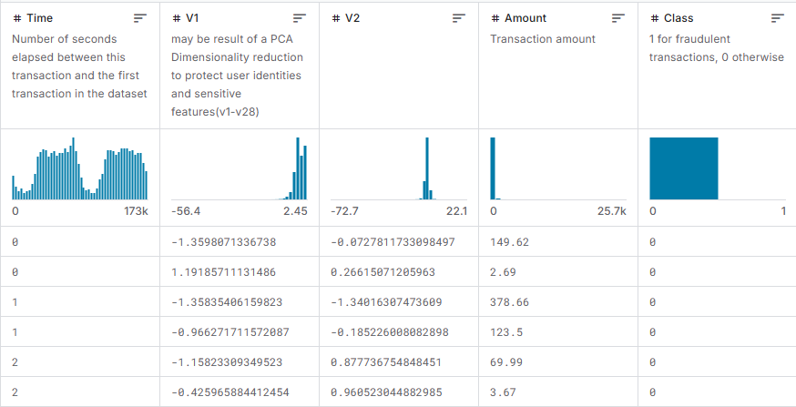
Dataset
The dataset contains two days of credit card transactions, with fraud cases making up just 0.17%.
Transactional data was transformed to protect customer privacy.
Key data are:
Time
Transactions
Amount
Class (Target)

Slide 6
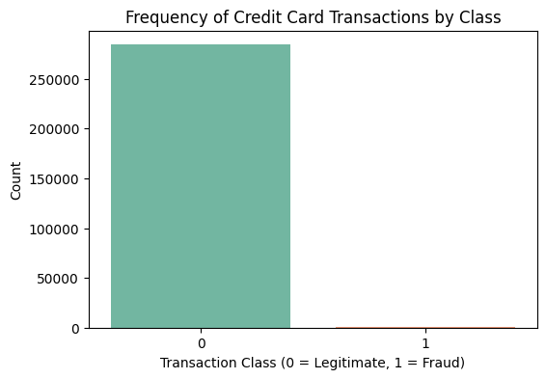
Challenges
High imbalance data:
Fraudulent transactions make up only a small fraction of the overall dataset.
Transformed features limits the ability to complete a detailed feature analysis.
Identifying all fraudulent transactions is crucial.

Slide 7

Our Approach
Conducted data analysis to uncover transaction patterns and trends.
Implemented techniques to correct the imbalance between fraudulent and legitimate transactions.
Evaluated different models:
Logistic Regression
XGboost
SVM
Prioritized finding a model capable of accurately identifying the majority of fraudulent transactions.

Slide 8
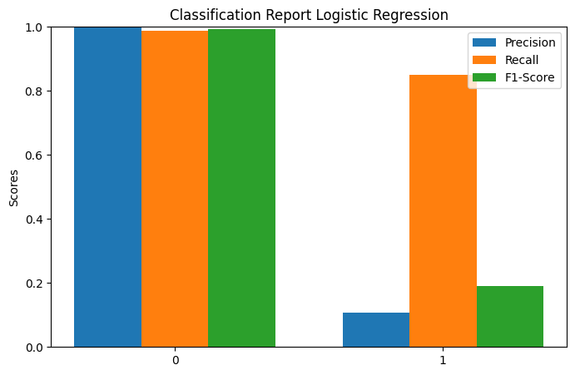
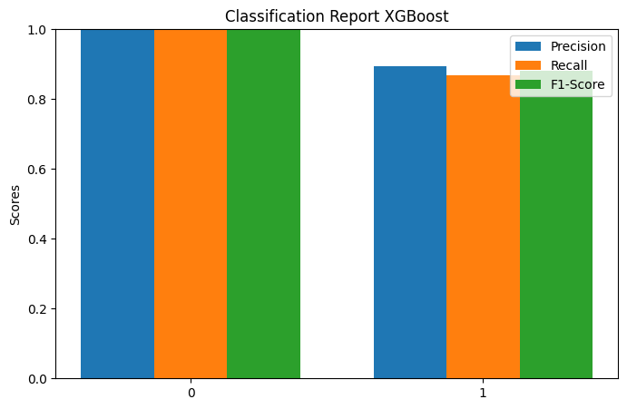
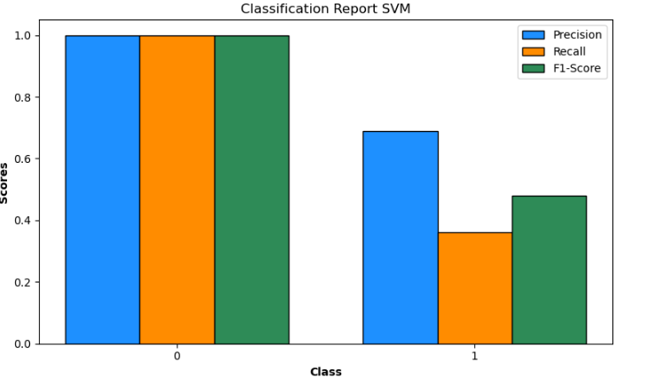
Results
Logistic Regression offered a reliable and easy to understand starting point. After some fine-tuning, it performed well and helped establish a solid baseline for fraud detection.
XGBoost delivered the strongest results, accurately identifying fraud while minimizing false alarms. It handled the data imbalance exceptionally well and is our top performing model.
Support Vector Machine (SVM) showed strong overall accuracy but struggled to catch many fraud cases, making it less effective for high-risk financial environment.

Slide 9

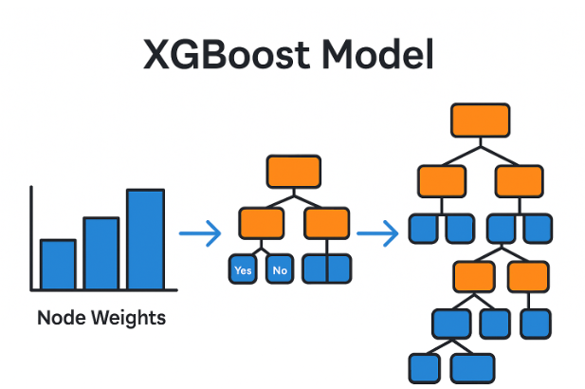
Best Model
The XGBoost Model is the best predictor of fraud.
Highly Accurate: The model correctly classified nearly all transactions, achieving overall accuracy near 100%.
Strong Fraud Detection: It identified 88% of fraud cases and correctly flagged them 91% of the time, minimizing missed fraud and false alarms.
Balanced Performance: With an F1 score of 0.90 for fraud, the model delivers a strong balance between catching fraud and avoiding disruption to legitimate customers.
Reliable at Scale: These results indicate the model is ready for real world deployment, offering both precision and trust in high volume environments.

Slide 10

Business Impact
Reduced Financial Losses: The model improves early detection of fraudulent transactions, helping to prevent costly chargebacks and fraud related expenses.
Improved Customer Trust: Accurate fraud detection minimizes disruptions to legitimate users, enhancing brand reputation and customer loyalty.
Improve Customer Satisfaction: Deliver a safer, more seamless experience for customers.
Operational Efficiency: Automating fraud detection reduces reliance on manual review teams, cutting labor costs and speeding up response times.
Scalability and Real-Time Use: The solution can be integrated into live transaction systems, allowing for scalable fraud monitoring as transaction volume grows.
Data-Driven Decision Making: Insights from the model and feature importance enable smarter risk management and targeted fraud prevention strategies.

Slide 11
Risk and Mitigation
Missed Fraudulent Transactions:
Mitgation: Deploy a real time fraud monitoring system to detect threats instantly.
Mitigation: Implement expert review for borderline cases and continuously refine model. thresholds
Bias or Unfair Outcomes:
Mitigation: Monitor performance across different customer segments and validate fairness metrics periodically.
Model Drift Over Time:
Mitigation: Schedule regular model retraining with updated transaction data to maintain accuracy.
False Positives Impacting Customers:
Mitigation: Fine-tune the model to balance precision and recall and introduce manual review for flagged high-value transactions.
System Integration Challenges:
Mitigation: Use modular APIs and cloud-based deployment strategies to ensure smooth integration with existing fraud systems.

